Slide 1


Chapter 8
Using servers for sharing and storing information

Slide 2
Learning objectives
1. How to provide facilities for server storage
2. What is Node.js
3. How to sync the device storage with server-side storage

Slide 3
Designing the server-based Thyroid app
Need to change the design of the login page.
Multiple users can access their own individual data on the same device.
add a field for the user’s email address, which is used as a username.
add a “Create New User” menu option, which will allow new users to sign up.

Slide 4
Signing up to a server-based app
Server-based apps are divided into client-side and server-side computing.
Client-side scripting includes all code run in the browser, such as all the JavaScript we’ve looked at.
Server-side scripting includes any code run outside of a browser on a server.
The server that our apps will run on has all the necessary technologies installed.
Node.js (server-side JavaScript), mongoDB (a NoSQL database server), and MySQL (SQL/relational database server).
The URL for accessing our app on this specialized server is http://140.184.132.239:3001.

Slide 5
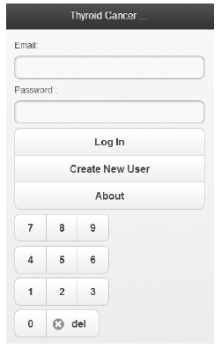
Modified login screen
Need a unique ID for each user.

Slide 6
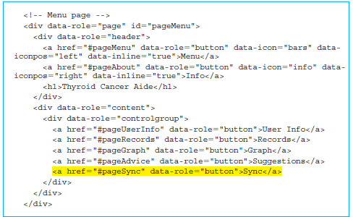
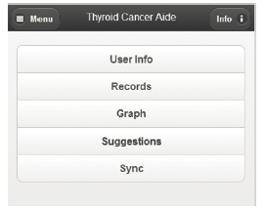
Syncing the records between the device and the server
An additional button for syncing the device data with the server database is shown below.

Slide 7
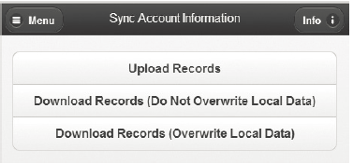
Sync page
Three buttons:
The first button allows us to upload the records from the device to a database on the server.
The remaining two buttons are for downloading the records.
The middle button downloads only the records from the dates that do not exist on the device.
The last button wipes the existing data on the device and loads the records from the database server.

Slide 8
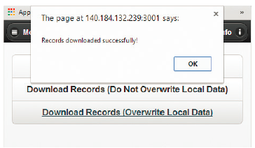
Confirmation screenshot of record download with overwriting of the local data for server-based Thyroid app
Go back to the Sync page and download the records (overwrite the local data) as shown by the confirmation in the figure below.

Slide 9
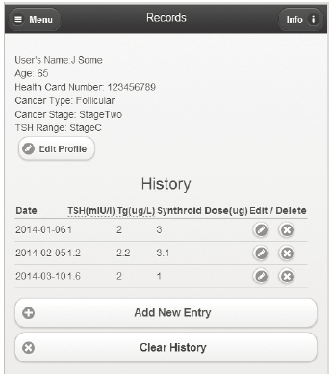
Screenshot of Records page after downloading records by overwriting the local data for server-based Thyroid app
Go back to the Records page to confirm that the original records have been restored.

Slide 10
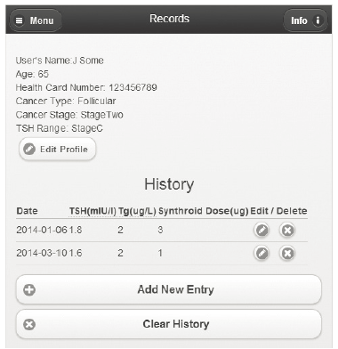
Screenshot of Records page after deleting one record and changing another one for server-based Thyroid app
Delete one of the records and change the TSH value of the first remaining record.

Slide 11
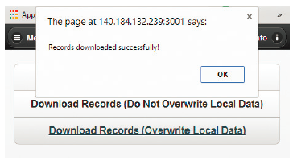
Confirmation screenshot of a record download without overwriting the local data for server-based Thyroid app
Go back to the sync page and download the records (do not overwrite the local data).

Slide 12
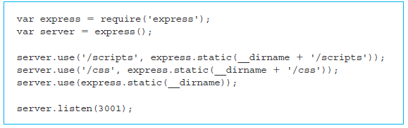
Programming with Node.js
As the Node.js file is in our Thyroid app directory, the server will host files for our Thyroid app.
Node.js is a platform or runtime environment that can be downloaded from nodejs.org and installed on any computer.
Built on Chrome’s (Google V8) JavaScript engine, which is open-source developed for the Google Chrome web browser.

Slide 13
Launching a Node.js app server
Launch our server running the Thyroid app by running the app-server.js with the command: node app-server.js
The command node invokes the Node.js runtime, and we are passing our file as the script that will be executed by Node.js.
var express = require('express');
Use the JavaScript global variable called __dirname

Slide 14
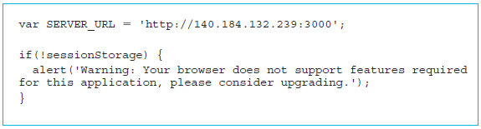
Modified navigation in the server-based Thyroid app
Replace localStorage with sessionStorage, since we want the longer-term storage to be coming from the server.
Simplified the code by not checking to see if the storage is exceeded through a try and catch block.

Slide 15
$.post method
$.post method sends a request to the server.
The $.post method takes three parameters:
• The first parameter is the URL. In our case it will be a concatenation of the SERVER_ URL with the string “/login”. That will make it ‘http://140.184.132.239:3000/login’.
• The second parameter is the JSON object loginCredentials, which is passed as a parameter.
• The third parameter is an anonymous function that accepts data returned by the server as a parameter.

Slide 16
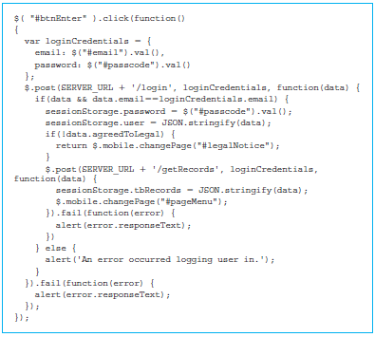
Error-handling feature
First fail() function corresponds to the second $.post() call corresponding to the request ‘http://140.184.132.239:3000/getRecords’.
The last piece of code in the figure below handles the possible failure of the first $.post call corresponding to the request ‘http://140.184.132.239:3000/login’.

Slide 17
Modified user form management in server-based Thyroid app
saveUserForm()
First check to make sure that the information in the form is correct using the function checkUserForm().
Then create the JSON user object using the elements from the form as we had done before.
The function saveUserForm() in the new version may be called either to save changed information of an existing user or to create a new user.
Distinguish between the two based on the value of the button element btnUserUpdate.

Slide 18
Implementing the syncing of records in the server-based Thyroid app
First check to make sure that the tbRecords field exists in sessionStorage.
If the records exist, we create a JSON object called requestBody.
It has three attributes: email, password, and newRecords.
The email attribute is obtained by using JSON.parse() on the sessionStorage.user object to recover its email value.
The password attribute is the same as the password field from the sessionStorage.

Slide 19
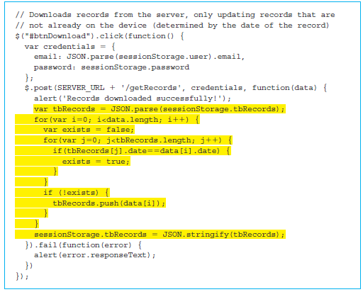
Downloading records (no overwrite) for server-based Thyroid app File: Sync.js

Slide 20
Quick facts/buzzwords
Node.js
NoSQL
Google V8
require()
express
sessionStorage
post()
fail()

